Slide 1
Describing Your Community: Rural Data for Rural Cancer Efforts
Iowa Cancer Consortium
Whitney Zahnd, PhD
May 25, 2023

Slide 2


Grant Applications and Needs Assessments
Non-Profit Grants
Problem Statements/Needs Assessments
Service Areas
Populations Served
Needs Assessments
Community definition (geography, populations, etc.)
Health needs

Slide 3
Characteristics of Data Sources Introduced
County-based
Relatively complete across all Iowa rural counties
Freely Available
Relevant for describing community populations, cancer burden, healthcare access
Most have either interactive maps, downloadable data, and/or are otherwise straightforward to access
Not exhaustive, nor inclusive of DHHS data!

Slide 4

Communities and People

Slide 5
Rural Health Information Hub
www.ruralhealthinfo.org/states
State Guides:
  Demographic background (e.g., race/ethnicity, age, veterans, tribal)
  Health disparities
  Healthcare facilities
  Social determinants of health
Rural Data Explorer:
https://www.ruralhealthinfo.org/data-explorer
Guide for finding rural data: https://www.ruralhealthinfo.org/topics/statistics-and-data

Slide 6
American Community Survey
The American Community Survey (ACS) is a continuous survey performed by the U.S. Census Bureau that collects data on demographics, socioeconomic factors, housing etc.
Data are available at the census tract, ZCTA, and county levels 5-year estimates will be need to be used for these geographic levels (e.g., 2016-2020)
Other means of access:
  Some of these data are available in the County Health Rankings data downloads
  See also the National Historical Geographic Information System (NHGIS)

Slide 7
National Association of Counties
County Explorer
  Demographics
  Health
  Economy
  Education
  Transportation
  Etc.
Maps, profiles, comparisons
Allows for comparison to other Iowa counties or other similar sized counties

Slide 8
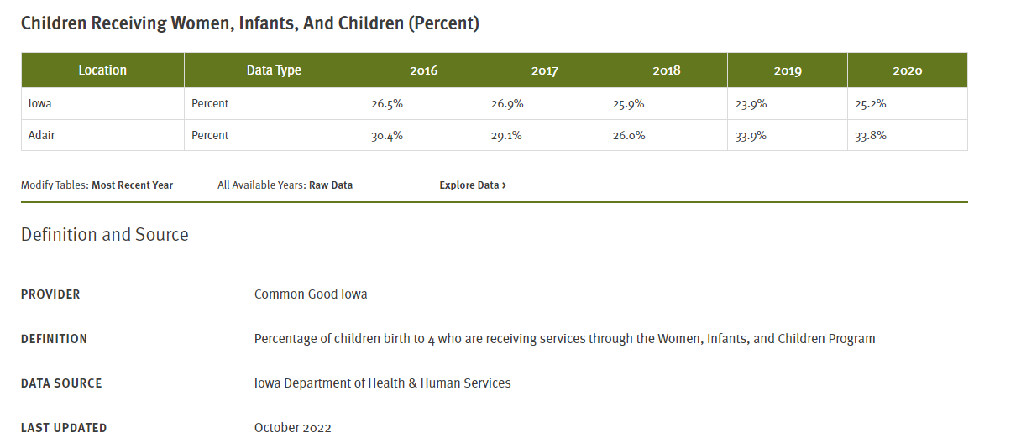
Annie E. Casey Foundation
Kids Count Data Center
  Demographics
  Economic Well-Being
  Family and Community
  Health
  Safety and Risk Behaviors
  COVID-19
  Youth and Young Adults

Slide 9

Cancer Burden, Screening,
and Relevant Behaviors

Slide 10
Sources of Data on Cancer Burden, Screening, and Relevant Behaviors
State Cancer Registry
Behavioral Risk Factor Surveillance System (BRFSS)
CDC WONDER
State Cancer Profiles
CDC PLACES
TeenVaxView

Slide 11
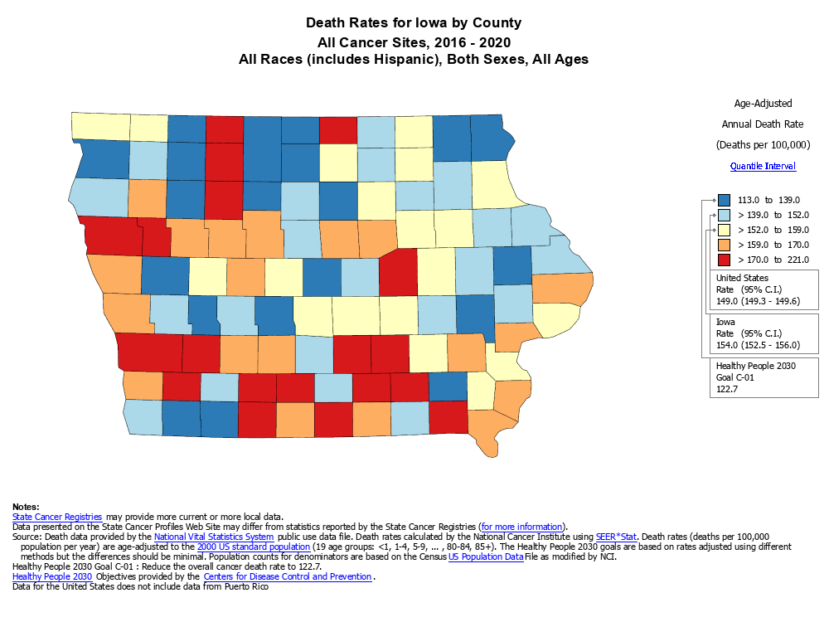
State Cancer Profiles
www.statecancerprofiles.cancer.gov
State Cancer Profiles include state and county-level data:
  Demographics
  Screening and Risk Factors
  Incidence
  Mortality
Maps, downloadable tables, graphs of trends
No statewide rural-specific data, but county-level data can bel helpful (e.g., identifying high mortality counties—are these rural?)
Caveats: some county-level data are somewhat dated, some states don’t report cancer data, some data are suppressed

Slide 12
United States Cancer Statistics: Data Visualizations
https://www.cdc.gov/cancer/uscs/index.htm
Cancer incidence and mortality rates by county and Congressional District and cancer type (2020* or 2016-2020)
* 2020 data should be interpreted with caution due to the pandemic

Slide 13
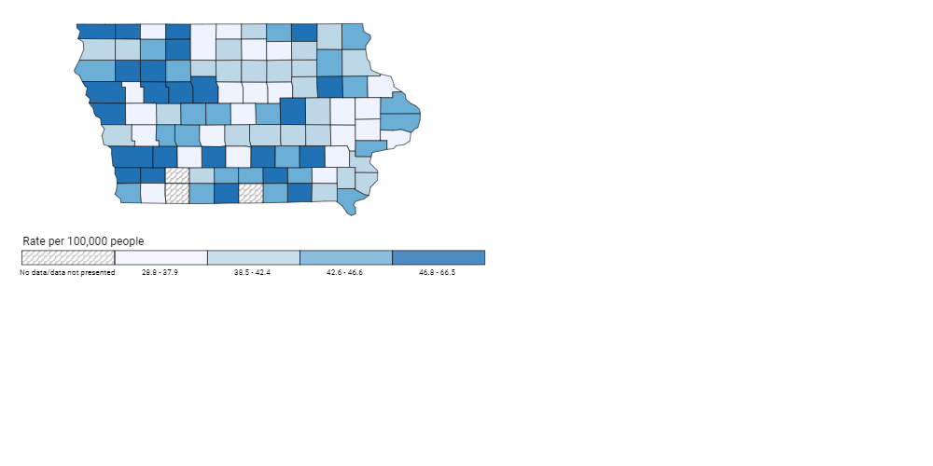
Rate of New Cancers in Iowa
Colon and Rectum, All Ages, All Races and Ethnicities, Male and Female, 2016-2020
Source - U.S. Cancer Statistics Working Group. U.S. Cancer Statistics Data Visualizations Tool, based on 2022 submission data (1999-2020): U.S. Department of Health and Human Services, Centers for Disease Control and Prevention and National Cancer Institute; https://www.cdc.gov/cancer/dataviz, released in June 2023.

Slide 14
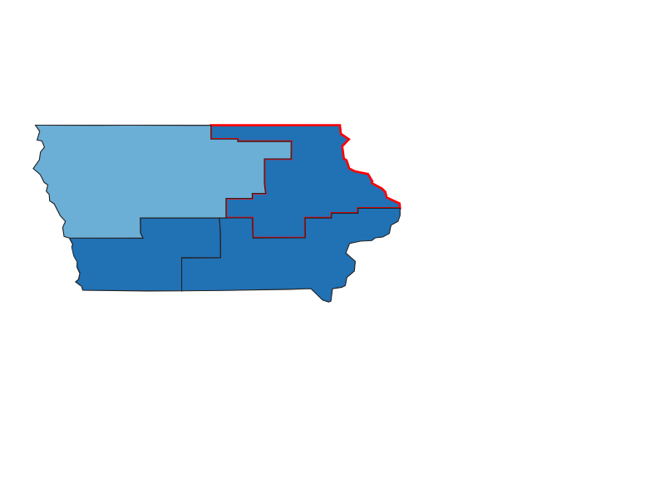
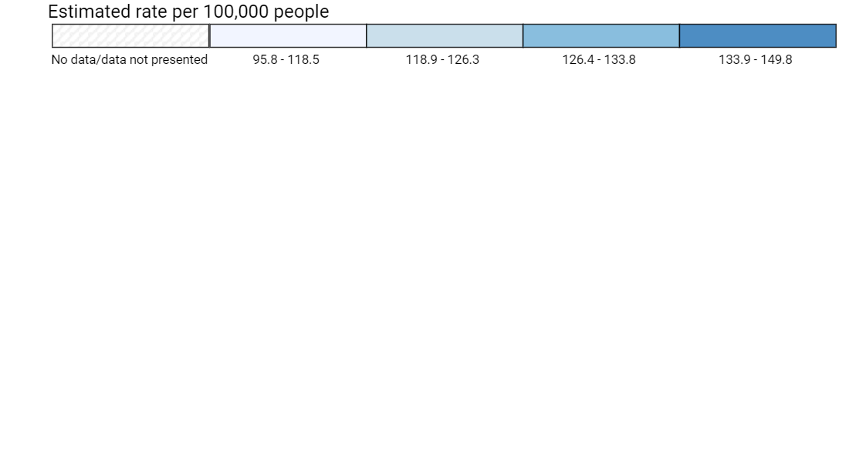
Estimated Rate of New Cancer Cases in the United States, by Congressional District, 2016-2020
Iowa, Congressional District 1, Female Breast, Male and Female, All Races and Ethnicities
Attention: Incidence and death counts and rates presented in the Congressional districts tab are estimates derived from county-level data. These point estimates are provided to describe the cancer burden in the selected congressional district and are not meant for comparisons across congressional districts.
Source - U.S. Cancer Statistics Working Group. U.S. Cancer Statistics Data Visualizations Tool, based on 2022 submission data (1999-2020): U.S. Department of Health and Human Services, Centers for Disease Control and Prevention and National Cancer Institute; https://www.cdc.gov/cancer/dataviz, released in June 2023.

Slide 15
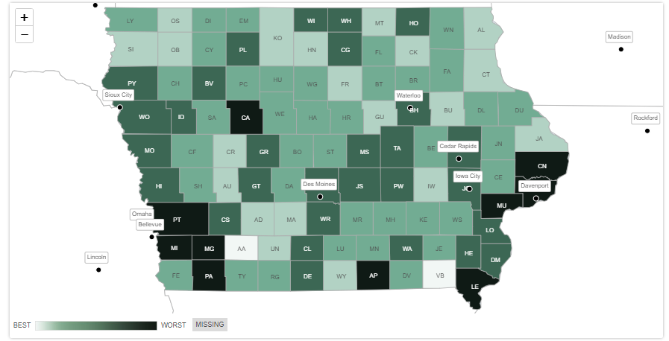
County Health Rankings
County Health Rankings considers many factors to rank counties within a state based upon policies and programs, health factors, and health outcomes
The Rankings pull together data from many sources for this ranking
Components include:
  Health Outcomes (Length and Quality of Life)
  Health Factors (Behaviors, Clinical Care, Social and economic factors, physical environment)
  Additional measures
Low Birthweight in Iowa Counties

Slide 16
CDC PLACES Data
CDC PLACES data include data on county, census-tract, or places throughout the country
Data types:
  Health outcomes
  Prevention
  Health risk behaviors
  Health Status
Includes an interactive map and data downloads

Slide 17
CDC WONDER Data
CDC WONDER provides information on public health data including deaths by cause (including cancer—ICD-10 codes:C00-C97)
All cancer and cancer-specific crude and age-adjusted mortality rates by non-metropolitan and metropolitan comparisons or other combinations of the CDC’s Urban-Rural Classification of Counties
  You can also stratify by race/ethnicity, age, and gender
  Trends and combined year analyses (best practices: use 5-year estimates)
  You can do county-specific mortality rates, but even for 5 years combined you’re likely to have suppressed data
Can generate text files

Slide 18
Institute of Health Metrics and Evaluation
US Health Map—county level estimates
  Life Expectancy
  Mortality
  Risk Factors
Subgroups available (e.g. gender, race/ethnicity, age) for some measures

Slide 19

Health Care Access

Slide 20
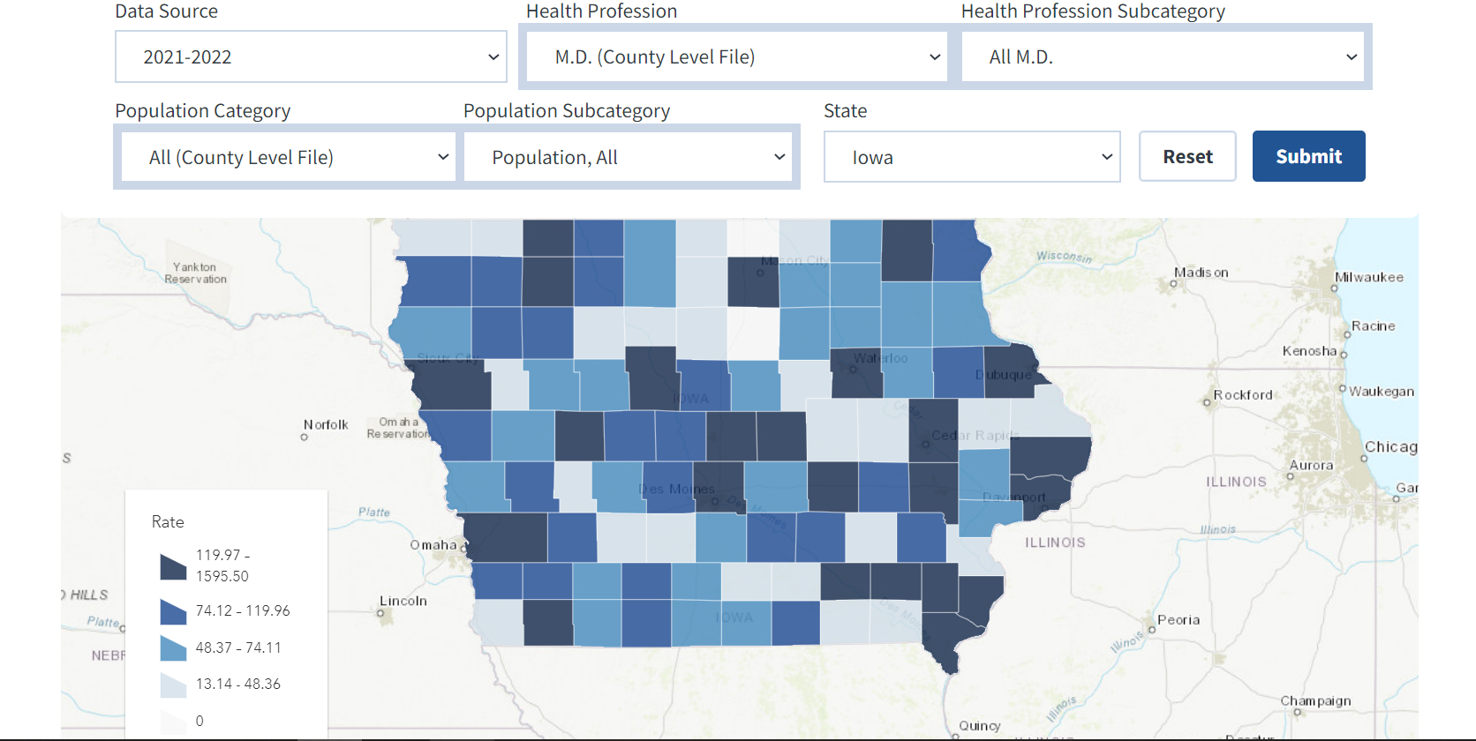
Area Health Resources File
Area Health Resources File includes county-level data on health care professions, health facilities, population characteristics, economics, health professions training, environment, and more
Data are available as an interactive map, excel or SAS file, or PDF

Slide 21
Insurance Status
Georgetown University Health Policy Institute Medicaid Coverage (2020-2021)
  Children
  Non-Elderly Adults
Census Small-Area Health Insurance Estimates

Slide 22

Iowa Specific Sources

Slide 23
Iowa Cancer Registry
County Level Data on Cancer Incidence and Mortality
  # of cases
  Age-adjusted and crude rates

Slide 24
Iowa Health Fact Book
County-level Data on the following elements:
  Demographic
  Social Determinants of Health
  Health Behaviors
  Mortality (overall, injury, etc)
  Healthcare providers
  Etc.
Data are also available by Public Health Region and Congressional District

Slide 25
Office of Statewide Clinical Education Programs
Tracking of health professionals in Iowa
  Pharmacists
  Nurse Practitioners
  Dentists
  Physicians
  Physician’s assistants
Reports online
Statistics, mailing lists etc. available for purchase

Slide 26

Iowa Rural Health Association Annual Conference
October 18th in Marshalltown
  https://iaruralhealth.org/2023-irha-conference/
Registration opening tomorrow!

Slide 27
Questions?
Whitney Zahnd, PhD
Assistant Professor
Department of Health Management and Policy
whitney-zahnd@uiowa.edu
https://www.public-health.uiowa.edu/hmp/

